Slide 1
2015 Marina/Boatyard Industry Survey
University of Wisconsin-Madison
Docks and Marinas,
Dec. 2, 2015

Slide 2
Marina Industry Survey Why are survey statistics important?
Industry performance statistics are underutilized by the marina industry.
Important for the growth of the industry (finding investors, especially firms new to marina/waterfront development)
Vital to your own growth and planning (gauging how your business performs against your peers)

Slide 3
Survey Topics
Respondent profile – does this reflect the general population? (State, waterbody, size, ownership, age)
The Breakdown
Region
Size/#of Slips
Ownership
Type of facility
Age of the facility
Occupancy and Rates
Products/Services
Revenues and Expenses
Gross Profit
National Perspective–gauge the overall health of the industry as a whole

Slide 4
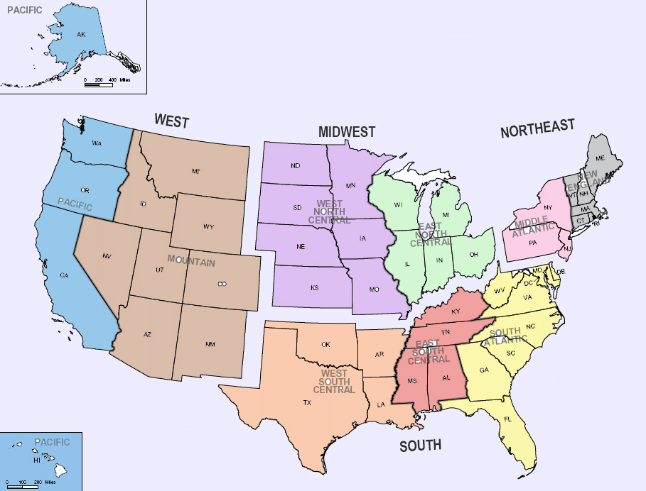
WEST
18%
MIDWEST
18%
NORTHEAST
26%
3%
15%
11%
15%
15%
28%
3%
5%
5%
SOUTH
38%
Respondent Profile

Slide 5
Respondent Profile
by waterbody
Great
Lakes
11%
Ocean-
West Coast
11%
Inland-
West
8%
Inland-
Central
10%
Ocean-
East Coast
34%
Inland-
East
24%

Slide 6
Corporate
12%
Other 5%
Gov’t
19%
Private
66%
Respondent Profile
by ownership

Slide 7
Respondent Profile facility size/# of slips
Very Large- 4%
Small-
30%
Large-
31%
Medium-39%

Slide 8
Mission: Find out how is the industry doing?
What’s the final destination?
Overall, our statistics show over the last five years that occupancy rates continue to rise and the number of facilities with increased profits is rising also.
What’s our map? How do we get there?
Occupancy Rates
Gross Profit
Revenues/Expenses (Product/Services)
Rates/Expenses

Slide 9
Occupancy 2015
Current overall rate %
The majority (59%) of facilities have an occupancy rate at 94 percent or above.
About one-third (35%) of facilities have an occupancy rate at 50 to 84 percent or above.
Only 3% of facilities have an occupancy rate below 50 percent.

Slide 10
2015 Occupancy
Compared to 2014
The majority (54%) of facilities have higher occupancy than 2014.
This is a trend going back to our statistics in 2009.

Slide 12
Gross Profit how did it compared to 2014
The majority (60%) of facilities have increased profits compared to last year.
This is a trend going back to 2011.

Slide 14
Review: 2015 Occupancy Rates and Gross Profit, compared to the previous year, as well as five- to seven-year trends.
A closer look at….
2015 regional trends in occupancy rates and gross profit.

Slide 15
2015 OccupancyCompared to 2014
REGIONAL TRENDS
South had the largest percentage with increased occupancy rates (61.1%).
The Northwest and Midwest and West were very similar with around half reporting increases (50% and 45%, 46.2%).
And the West had zero facilities reporting decreased occupancy rates.
Overall, very few facilities were reporting decreased occupancy rates.

Slide 16
2015 Gross profit, compared to 2014
REGIONAL TRENDS
West had a huge percentage reporting increased profits (80.7%), compared to last year, and similar to the Midwest and South.
Northeast had the least with increased profits (39%) and the largest percentage with decreased profits (17%). The Northeast also had a large majority with steady profits.

Slide 17
What makes marina and boatyard businesses successful?
2015 (and beyond) statistics – occupancy rate, gross profit
Overall health of the whole marina/boatyard industry, and a regional perspective
Next:
Revenue Report:
individual
product/services
Glimpse into what profit centers
are most successful

Slide 18
2015 Product/Service Revenues
compared to 2014
Leased Slips
Transient Slips
Dry Storage
Moorings
Launch Ramp
Fuel
Restaurant
Commercial/Retail Lease Space
Ship/Convenience Store
Boat Maintenance and Repair
Haul-out/Winterization Services
Self-Service Repair
New Boat Sales/Brokerage
Used Boat Sales/Brokerage
Pumpout
Boat Club
Boat Rental
Water Toy Rental
Tour Boat/Charter Fishing/Water Taxi
Event services/Venue
Cabin/Campground/RV Park
Sailing/Training School
SURVEY QUESTION:
Did revenues for each product/service increase, decrease or stay the same, compared to the previous year?

Slide 19
2015 Product/Service Revenues
compared to 2014
Percentage of facilities with increased revenues:
Leased Slips – 54.3%
Fuel – 49%
Boat Maintenance – 49%
Dry Storage – 47%
Used Boat Sales – 46%
Ship/Convenience Store – 45%
Restaurant – 44%
Boat Rental – 44.4%
Water Toy Rental – 40%
Transient slips – 40%
Percentage of facilities with decreased revenues:
Fuel – 27%
New Boat Sales – 19%
Restaurant – 12%
Ship/Convenience Store – 14%
Boat Maintenance – 12%
Transient Slips – 12%
Haul-out/Winterization – 13%

Slide 20
2015 Leased Slip Revenues
compared to 2014
#1. Highest percentage of increased revenues (53.4%)
REGIONAL TRENDS
West and South have slightly higher increases, compared to Midwest and Northeast – but all very close.

Slide 21
2015 Fuel Revenues compared to 2014
REGIONAL TRENDS
#2 increased revenues (49%);
Highest reported decrease in revenues (27%)
Midwest had huge increases in fuel revenues, while the West had half that percentage.
The South had larger decreases in fuel revenues, nearly 1/3, and the Northwest had about a quarter.
The West had the fewest reported decreases in revenue, and a large percentage with steady fuel revenues.

Slide 22
2015 Boat Maintenance/Repair Revenues
compared to 2014
#3 in increased revenues (49%);
#5 in decrease in revenues (12%)
Midwest is reporting big increases (70.6%), and the Northwest had the lowest increased revenues, (34.6%).
No one in the West was reporting decreased revenues, and it was varied across the other regions, from 7 to 21%, with the South reporting the highest percentage with decreased profits.

Slide 23
2015 Dry Storage Revenues
compared to 2014
#4 in increased revenues (47%)
REGIONAL TRENDS
Midwest again had highest increases in dry storage revenues (61%), with the other three regions fairly close in numbers.
Again, no facilities in the West reported decreased dry storage revenues. Both the South and Northwest reported about 15%, with the Midwest in at less than half that, 6%.

Slide 24
2015 Ship Store/Convenience Revenues
compared to 2014
#6 in increased revenues (45%);
#4 in decreased revenues (14%)
South, Midwest and West all had similar revenue increases around 50%.
The Northwest had significantly lower increased revenues (28%), but a large majority with steady revenues (60%).
The South had the largest report of decreased revenues at the ship store.

Slide 25
Review:
2015 Occupancy Rates and Gross Profit, compared to the previous year, as well as five- to seven-year trends. (Overall health)
2015 regional trends in occupancy rates and gross profit. (Regional perspective)
Product/service profit centers with the largest increases and decreases in profits. (Overall industry and regional trends)
Next…a couple more pieces to the puzzle…

Slide 26
Other factors contributing to the success or failure of a marina/boatyard?
Survey topics:
Expenses – if you pay out more, profits decrease.
Rates – if you’re charging less, profits decrease.

Slide 27
2015 Rates, compared to 2014
The majority of facilities (51%) kept rates steady, compared to last year, and large number (45%) increased rates. Very few decreased rates 4%).

Slide 28
2015 Expenses, compared to 2014
A large two-thirds majority (67%) had increased expenses, and one-quarter (26%) had steady expenses and very few decreased expenses.
EXPENSES: Staff Personnel; Staff Benefits; Maintenance/renovations; Capital expenditures/expansions; Product inventory; Customer/community events; advertising/marketing; insurance; mortgage/rent; equipment; utilities; taxes.
Next: a look at the long-term trend for expenses, compared to last year, show something interesting…

Slide 30
In conclusion…
The majority of facilities have a high occupancy rate for 2015; the majority have a higher occupancy than the year before; and the South had the largest percentage with increases.
For the majority of the last seven years, occupancy rates have increased, with some slight decreases during a few years.
The majority of facilities have increased gross profits, compared to the year before, and the West reported the largest percentage with increases.
The five-year trend shows increased gross profits.
A look at some of the product/service profit centers with the largest increased profits and the largest decreased profits showed considerable difference across the regions.
For rates in 2015, 96% had steady or increased rates, which suggests strong markets.
Lastly, for expenses, a two-thirds majority had increased expenses, and the five-year trend shows a pattern of tightening and expanding of expenses, which mimic the overall economy.

