Slide 1


2016 Marina/Boatyard
Industry Survey
Anna Townshend
Marina Dock Age magazine editor
The Docks Expo,
Nov. 30, 2016

Slide 2
Marina Industry Surveys
Why are survey statistics important?
Industry performance statistics are underutilized by the marina industry.
  Important for the growth of the industry (finding investors, especially firms new to marina/waterfront development)
  Vital to your own growth and planning (gauging how your business performs against your peers)

Slide 3
Survey Topics
Respondent profile – does this reflect the general population? (by state, waterbody, size, ownership, facility age)
The Breakdown: cross tabulations results
Region
Size/# of Slips
Ownership
Type of facility
Age of the facility
Occupancy and Rates
Products/Services
Revenues and Expenses
Gross Profit
National Perspective–gauge the overall health of the industry as a whole

Slide 4
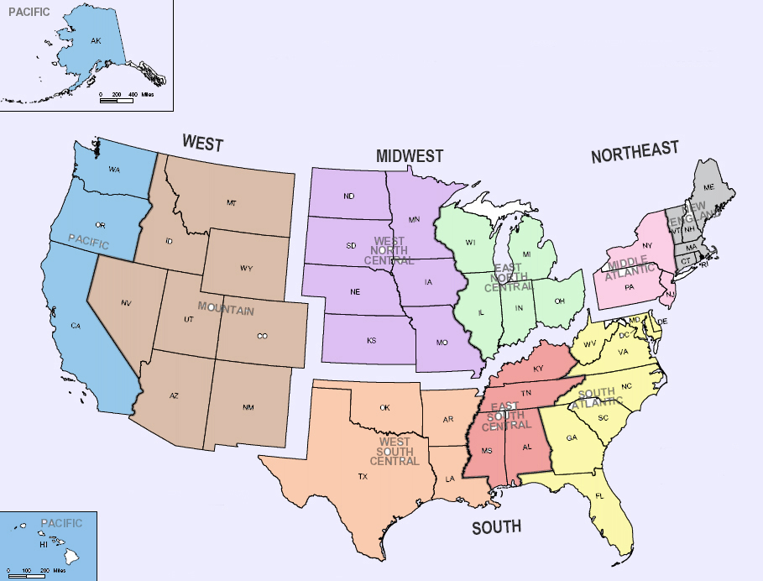
WEST
17%
NORTHEAST
18%
MIDWEST
19%
5%
14%
10%
8%
14%
36%
3%
4%
5%
SOUTH
45%
Respondent Profile

Slide 5
Respondent Profile
by waterbody
Great
Lakes
10%
Ocean-
West Coast
11%
Inland-
West
8%
Inland-
Central
13%
Ocean-
East Coast
35%
Inland-
East
20%

Slide 6
Other 13%
Respondent Profile
by ownership

Slide 7
Very Large (750 slips or more)- 4%
Small (less than 100 slips)-
22%
Large (250 to 749 slips)-
35%
Medium (100 to 249 slips)-33%
Respondent Profile facility size/# of slips

Slide 8
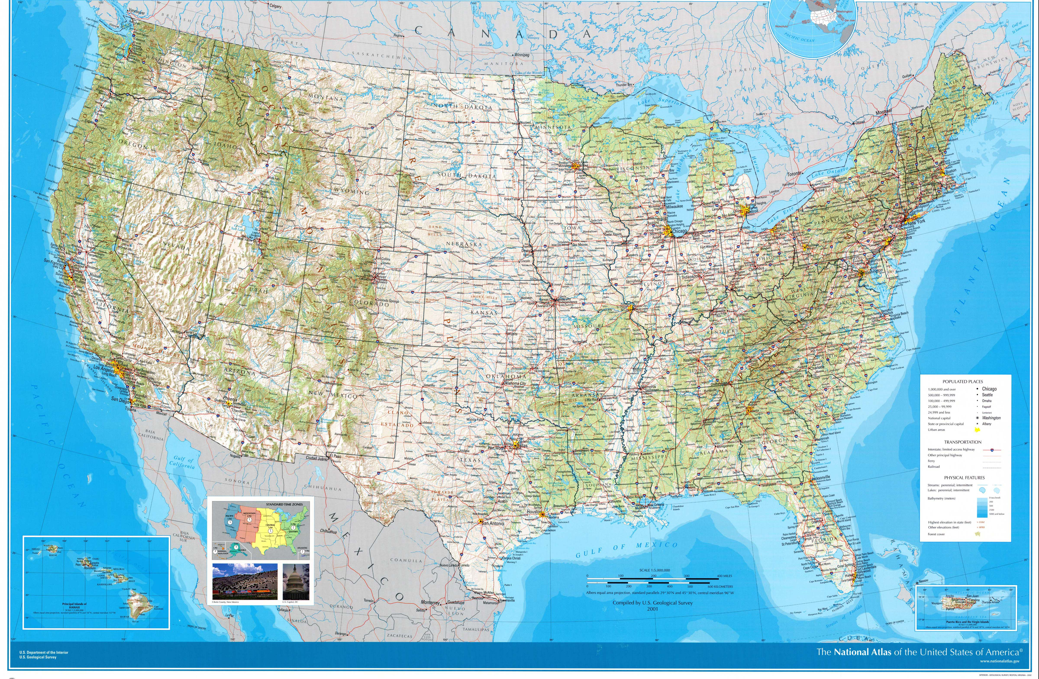
1. Mission: Find out how is the industry doing?
For individuals, find out how your business is doing in comparison to others.
3. What’s the final destination?
2. What’s our map? How do we get there?
NEW ANNUAL TRENDS REPORT!!
Overall, our statistics show over the last six to eight years that facilities with increased occupancy rates year to year have nearly doubled, and the number of facilities with increased profits continues to grow. Occupancy rates and profits both had large increases the last two years.
a. Occupancy Rates
b. Gross Profit
c. Product/Service Revenues
d. Slip/Service Rates
e. Expenses

Slide 9
2016 Occupancy
Current overall rate %
The majority (63%) of facilities have an occupancy rate at 85 percent or above. 36% had occupancy rates at 95 percent or above.
About one-third (30%) of facilities have an occupancy rate at 50 to 84 percent or above.
Only 4% of facilities have an occupancy rate below 50 percent.
NEXT: five-year trends

Slide 10
Facilities with less than 50 percent occupancy are consistently the minority.
Occupancy percentage rates between 75 to 100 percent vary significantly from year to year.

Slide 11
2016 Occupancy
Compared to 2015
The majority (56.8%) of facilities have higher occupancy than 2015.
NEXT: This is a trend in the statistics going back to 2009.

Slide 12
Except for 2009, the majority of facilities have had higher occupancy rates than the year before.
The number of facilities with lower occupancy rates is also declining steadily since 2011.

Slide 13
2016 Gross Profit compared to last year
The majority (63%) of facilities have increased profits compared to last year.
NEXT: This is a trend going back to 2011.

Slide 14
Except for a slight decrease in 2014, the number of facilities with increased gross profits has been on the rise.
The number of facilities with decreased profits has been declining since 2011.
Consistently, about one-quarter of facilities have steady profits.

Slide 15
Review:
Overall Respondent Profile;
2016 Overall Occupancy Rate, and the five-year trends;
2016 Occupancy, compared to previous year, and the eight-year trends;
Gross Profit, compared to the previous year, and six-year trends;
NEXT: A closer look at….
2015 trends in occupancy rates and gross profit
….based on regions, facility size and ownership

Slide 16
Occupancy 2015
Current overall rate %
By regions
Northeast has a higher number at 100 percent occupancy.
West has a higher number at 50 to 74 percent occupancy.
All regions had very few facilities at less than 50 percent occupancy.

Slide 17
Occupancy 2015
Current overall rate %
By facility size
The results here are similar across the board. Medium and very large facilities have slightly more facilities at 95 to 100 percent occupancy.
Overall, a varied number of facilities have occupancy rates from 50 to 100 percent. Very few facilities have occupancy at less than 50 percent. Small facilities have slightly more at low occupancy, than other sized facilities.

Slide 18
Gross Profit, compared to 2015
BY REGIONS
The South and Northeast have slightly more facilities with increased profits, than the Midwest and West.

Slide 19
2016 Gross Profit, compared to last year
BY OWNERSHIP
Corporate/management firms (73%) have a larger percentage with increased gross profits.
Government facilities have a larger number with steady, rather than decreasing gross profits.

Slide 20
2016 Gross Profit, compared to last year
BY FACILITY TYPE
Boatyard (service only) facilities have a larger number with increased gross profits, compared to other types of facilities. They also have a larger number with decreased profits and none with steady profits.

Slide 21

What makes marina and boatyard businesses successful?
Review:
2016 statistics (and beyond) – occupancy rate, gross profit
Overall health of the whole marina/boatyard industry, and a look at the industry based on regions, size and ownership
Next:
Revenue Report:
individual
product/services
Glimpse into what profitcenters
are most successful

Slide 22
2016 Product/Service Revenues
compared to 2015
Leased Slips
Transient Slips
Dry Storage
Moorings
Launch Ramp
Fuel
Restaurant
Commercial/Retail Lease Space
Ship/Convenience Store
Boat Maintenance and Repair
Haul-out/Winterization Services
Self-Service Repair
New Boat Sales/Brokerage
Used Boat Sales/Brokerage
Pumpout
Boat Club
Boat Rental
Water Toy Rental
Tour Boat/Charter Fishing/Water Taxi
Event services/Venue
Cabin/Campground/RV Park
Sailing/Training School
SURVEY QUESTION:
Did revenues for each product/service increase, decrease or stay the same, compared to the previous year?

Slide 23
2016 Product/Service Revenues
compared to 2015
Percentage of facilities with increased revenues:
Leased Slips – 60%
Boat Maintenance – 49%
Transient slips – 48%
Boat Rental – 47%
Restaurant – 46.7%
Dry Storage – 46%
Fuel – 44.5%
Ship/Convenience Store – 43%
Percentage of facilities with decreased revenues:
Fuel – 23%
Transient Slips – 13%
Boat Maintenance – 12%
Launch Ramp – 10.7%
Ship/Convenience Store – 10%
Leased Slips – 9%
Pumpout – 9%
NEXT: annual trends for top product/service
THEN: regional numbers

Slide 24
2016 Leased Slip Revenues
2011 to 2016
Leased slip revenues continue to increase steadily, at their highest point since 2011.
Similarly, those reporting decreased revenues are on a steady decline.

Slide 25
2016 Boat Maintenance/Repair Revenues
compared to 2015
The majority of facilities since 2011 have had increased revenues, including big jumps in 2012 and 2015.

Slide 26
2016 Transient Slip Revenues
2011 to 2016
Those reporting decreased revenues have been on a decline since 2011, except for a slight increase this year.
The numbers for those with increased and steady revenues varied more.

Slide 27
2016 Leased Slip Revenues
compared to 2015
#1. Highest percentage of increased revenues (60%); 6th in reported decreased revenues (9%)
REGIONAL
TRENDS
Northeast had more with increased leased slip revenues (74%).
The West had the least number with increased revenues (47.3). The West also the largest number with decreased revenues (13.2%).

Slide 28
2016 Boat Maintenance Revenues
compared to 2015
#2. Highest percentage of increased revenues (49%); 3rd in reported decreased revenues (12%)
REGIONAL
TRENDS
The South leads the way in boat maintenance/repair revenue increases (56%).
The West has the lowest number with increased revenues and a large number with decreased revenues.

Slide 29
2016 Transient Slip Revenues
compared to 2015
#3. Highest percentage of increased revenues (48%); 2rd in reported decreased revenues (13%)
REGIONAL
TRENDS
Again, the Northeast leads the way, followed by the South, Midwest and West.

Slide 30
REVIEW:
2016 Occupancy Rate Percentage and Occupancy Rates and Gross Profit, compared to the previous year, as well as five- to eight-year trends. (Overall health)
2016 trends by region, facility size and ownership in occupancy rates and gross profit (current regional and facility specific trends)
Product/service profitcenters with the largest increases and decreases in profits and five-year trends for top performers (Overall industry and regional trends)
NEXT…a couple more pieces to the puzzle…

Slide 31
Other factors that contribute to the success or failure of a marina/boatyard?
Keep in mind, with increasing expenses like staff/personnel, capital expenditures, renovations and advertising/marketing may increase expenses in the short term, but often build profit for the future.
Survey topics:
Expenses – if you pay out more, profits decrease.
Rates – if you’re charging less, profits decrease.
Likewise, increasing rates may cause a temporary decrease in revenues, and set up increases for the future.

Slide 32
2016 Rates, compared to 2015
The majority of facilities (55%) kept rates steady, compared to last year.
A large number (43%) increased rates.
Very few decreased rates (2%).
This is a trend since 2012.

Slide 33
Since 2012, the majority of facilities have kept rates steady.
A small but still significant number were increasing rates. That was also on the rise from 2012 to 2015.
The number of those decreasing rates has remained low in comparison.

Slide 34
Gross Profit
2016 Rates, compared to 2015
By Ownership
More corporate/management firm facilities (61%) are increasing rates and gross profit.

Slide 35
2016 Expenses, compared to 2015
A large two-thirds majority (69%) had increased expenses.
One-quarter (24%) had steady expenses.
Very few decreased expenses (7%).
EXPENSES: Staff Personnel; Staff Benefits; Maintenance/renovations; Capital expenditures/expansions; Product inventory; Customer/community events; advertising/marketing; insurance; mortgage/rent; equipment; utilities; taxes.
NEXT: a look at the long-term trend for expenses, compared to last year, shows something interesting…

Slide 36
As the economy improved around 2012, more facilities increased expenses and fewer decreased expenses.
After a large increase in 2012 and 2013, those increasing expenses have hovered around two-thirds.

Slide 38
OTHER RESOURCES:
NEW: Available online
(www.marinadockage.com)
ANNUAL TRENDS REPORT
More statistics available in:
December 2015 Trends issue
January/February 2017 issues
Docks Expo program (Inland vs. Coastal)
Upcoming surveys:
Industry Survey, part two: Business Operations (slip sizes, rates, renovations, employee staffing and training, safety standards and more) – look for that survey online at the end of January – published in April 2017 issue
Clean Marina Survey 2017 -- published in May/June issue
Look for additional product surveys throughout the year

Slide 39
In conclusion…
The marina industry remains in a growth period, after some stagnant years from the economic downturn. The number of facilities with increased occupancy rates made big gains from 2014 to 2015 and more modest, but still substantial, gains this year.
  For 2016, occupancy rates did not vary widely across regions or facility sizes.
The number of facilities with increased gross profits, compared to the year before, continues to grow, at its highest point this year since we’ve been collecting stats, nearly double what it was in 2009.
  Gross profit did not vary widely across the regions or facility ownership; slightly more facilities in the South and corporate/management firms had increased profits.
The number of facilities with increased leased slip and boat repair/maintenance revenues were consistently the highest throughout the years. Transient slip revenues were more varied. Generally, the number of facilities reporting decreases in revenues was on the decline for all product/services.
  The different regions showed significant differences in the number of facilities reporting increased profits.
The majority of facilities are keeping rates steady. Also, a large number are increasing rates, and a small number decreasing rates. 98% were increasing or keeping rates the same.
  More corporate management firms are increasing rates, than private facilities.
The majority of facilities have increased expenses since 2012.
  South leading in many expense categories.

