Slide 1
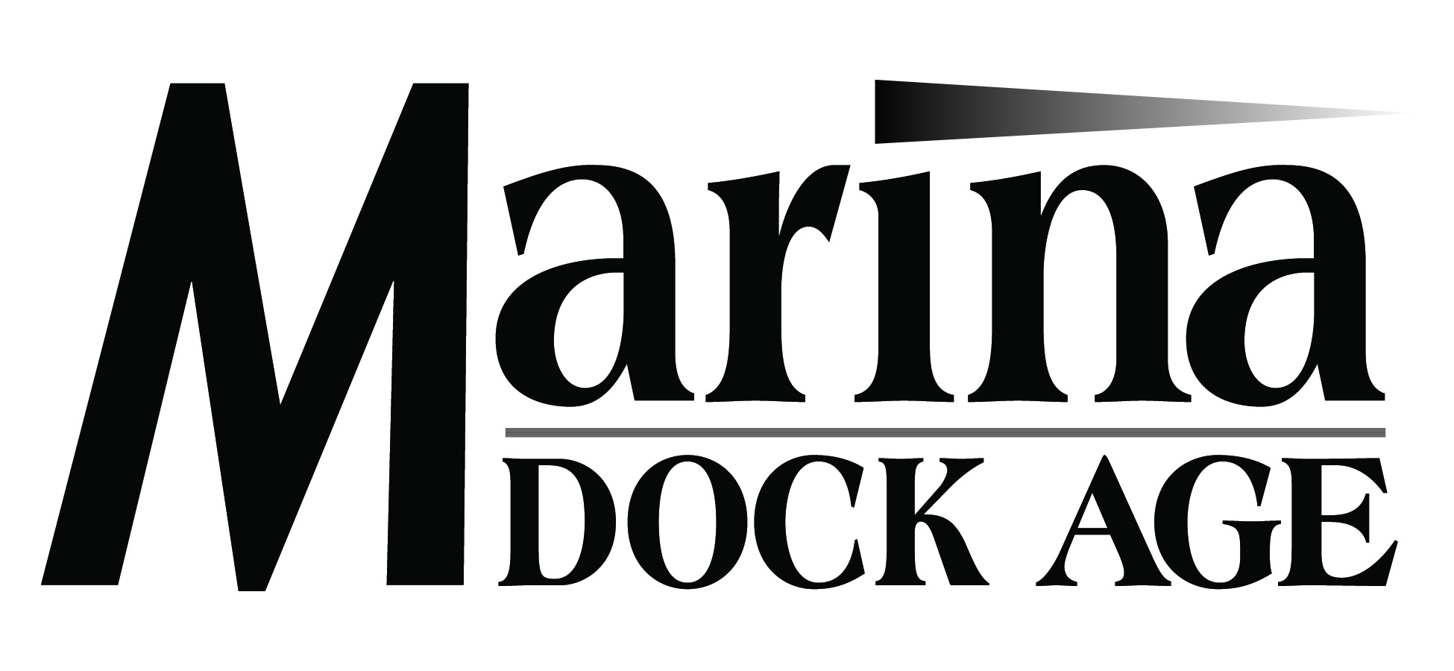
Clean Marina Survey 2013
Anna Townshend,
Marina Dock Age editor

Slide 2
Why Surveys?
Not a lot of marina data out there!
Overall, those outside the industry, especially investors, need benchmarks and numbers for comparison.
For those inside the industry, you can gauge the overall health of the industry/program.
Gauge your own health, in comparison to others.
Be an advocate for the marina industry data!
MDA surveys are conducted online, and can be found in e-newsletters and our website.
If you do not receive our surveys by email, please see me, or email me at atownshend@marinadockage.com.

Slide 3
Clean Marina Survey Statistics
Non-CM
Spring 2013
MDA April issue
Topics
Clean Marina Procedures/Practices
Most Challenging/Easiest
Purchasing Equipment
Infrastructure Changes
Cost Savings
Certification/Annual Costs
Time Investment
Why are you not a CM?
Where do you need improvement?
Cross-tabulation
Regional
Facility Size
Type of Facility

Slide 4
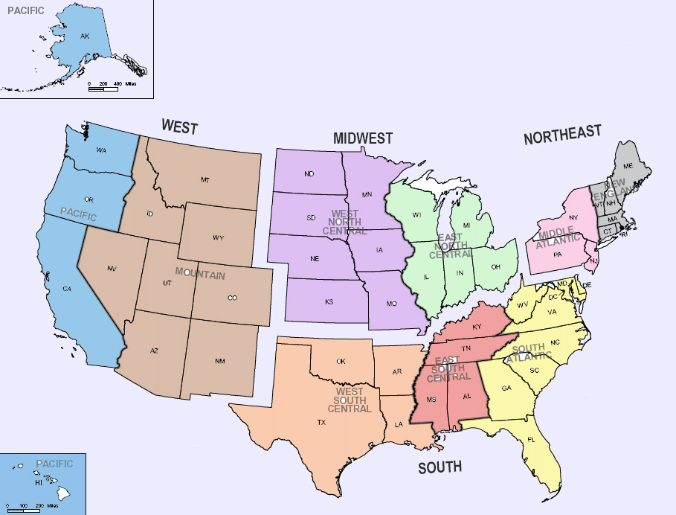
Respondent Profile – Regional/States
5%
6%
27%
13%
3%
Top States
California 16%
Florida 13%
Washington 8%
Maryland 7%
Virginia 6%
Minnesota 5%
South Carolina 5%
Michigan 4%
Wisconsin 4%
4%
36%
2%
4%
Regional –
Northeast 9% Midwest 18% South 42% West 31%

Slide 5
Respondent Profile – Type of Facility
Storage vs. Service
Boatyard 39%
Marinas 60%

Slide 6
Respondent Profile – Type of Facility/ regional
Marinas
Boatyards
2%
11%
6%
7%
11%
18%
35%
11%
0%
7%
39%
32%
3%
5%
3%
7%
2%
2%

Slide 7
Respondent Profile – Facility Size
Small (1 to 99)
24%
Large (250+)
44%
Medium (100 to 249)
31%

Slide 8
Clean Marina Procedures/Practices – Overall
In what areas, did you implement procedures or practices as part of the Clean Marina program?

Slide 9
Clean Marina Procedures/Practices – By Facility Type

Slide 11
Most Challenging Clean Marina Procedures/Practices -- REGIONAL

Slide 12
Most Challenging Clean Marina Procedures/Practices – By Facility Size

Slide 13
Most Challenging Clean Marina Procedures/Practices – By Facility Type

Slide 14
Easiest Clean Marina Procedures/Practices

Slide 15
Pollution Prevention Equipment
What equipment did you purchase for CM certification?
Vacuum sanders
Recycling tanks or bins
Washwater recycling system
Low flow toilets
Automatic light fixtures
Electric hand dryers
Fueling equipment
Storm drain filters
Oil booms
Infrastructure Changes

Slide 16
Infrastructure Changes – by size
Percentage of facilities (small, medium and large) that made infrastructure changes in each category

Slide 17
Clean Marina Costs/Time Investment
Total initial certification cost: $31,765
Northeast $71,438 Midwest $30,038
South $42,468 West $1,925
Marinas
$14,493
Boatyards$52,553
Small Medium Large
$201,000 $16,158 $26,629
Annual Environmental Costs for non-CMs – $30,482
Annual Environmental Costs: $7,286
Northeast $1,816 Midwest $30,038
South $42,468 West $3,368
Marinas
$4,129
Boatyards$11,406
Small Medium Large
$51,375 $3,223 $6,521
Estimate the total time investment from initial interest until final certification: 11 months
Northeast: 12 Midwest: 13
South: 12 West: 5
Small Medium Large
22 10 8

Slide 18
Clean Marina Cost Savings
Did you experience cost savings after being certified a Clean Marina?
REGIONAL

Slide 19
Clean Marina Cost Savings – by Facility Size/Size

Slide 20
Grant Funding for Certification or Compliance
About 1//3 used funding
CVA Funds (pumpout)
BIG Funds (transient vessels)
State/municipal funds

Slide 21
Funded Facilities (1/3) – REGIONAL

Slide 22
Clean Marina Questions?

Slide 23
Non-Clean Marinas – Respondent Profile, regional/states
Top States
North Carolina 13%
Florida 9%
New York 9%
Maryland 9%
Massachusetts 6%
Ohio 6%
California 4%
Connecticut 4%
Indiana 4%
New Hampshire 4%
New Jersey 4%
Rhode Island 4%
Texas 4%
Virginia 4%
19%
2%
9%
13%
17%
34%
0%
2%
4%
Regional –
Northeast 36% Midwest 15% South 40% West 9%
CMs – Northeast 9% Midwest 18% South 42% West 31%

Slide 24
What’s the number one reason why are you NOT a Clean Marina?
Clean Marina Costs vs. the Cost of Not Being a Clean Marina

Slide 25
Procedures/Practices for Pollution Control and/or Environmental Regulations for non-CMs

Slide 26
Most Challenging/Difficult Practices or Procedures for Non-CMs

Slide 27
In what areas, do you most need improvement?

Slide 28
Infrastructure Changes for Pollution Control or Regulation Standards – overall Non-CMs

Slide 29
Thank you!
Watch for MDA surveys all year round!
Questions, comments, concerns,
contact Anna Townshend,
atownshend@marinadockage.com
314-241-7355

