Slide 1
Marina Dock Age magazine Editor Anna Townshend
2016 Pumpout Survey Results

Slide 2
For almost 30 years, Marina Dock Age has been the only business-to-business publication dedicated 100% to the U.S. waterfront facilities segment of the marine industry.
Published eight times a year – Jan/Feb; March; April; May/June; July/August; Sep/Oct; Nov; Dec
Annual Trends Issue (December): covers current and future marina trends, including annual industry survey
Annual Buyer’s Guide (November 2016):
843 company listings in 63 marina industry categories
September/October 2016

Slide 3
Awarded in two categories: LARGE(more than 250 slips) and SMALL (less than 250 slips)
Past Winners:
2015: Harbour Town Yacht Basin, SC
Marina Jack, FL
2014: Glen Cove Marina, CA
Narrows Marina, WA
2013: Nantucket Boat Basin, MA
Southport Marina, NC
2012: Sunrise Harbor Marina, FL
Dillon Marina, CO
2011: Nestegg Marine, WI
Sunset Marina, MD
2010: Bridge Marina, NJ
Sevens Points Marina, PA
Deadline: October 1
2016 Marina of the Year awards will be presented on December 1 at 4:30 p.m. in St. Charles, Missouri, at

Slide 4
Marina Industry Survey Why are survey statistics important?
Industry performance statistics are underutilized by the marina industry.
Important for the growth of the industry (finding investors, especially firms new to marina/waterfront development)
Vital to your own growth and planning (gauging how your business performs against your peers)

Slide 5
Annual Industry Survey Topics
Respondent profile – general reflection of the population (State, waterbody, size, ownership, age)
The Breakdown
Region
Size/#of Slips
Ownership
Type of facility
Age of the facility
Occupancy and Rates
Products/Services
Revenues and Expenses
Gross Profit
National Perspective–gauge the overall health of the industry as a whole

Slide 6
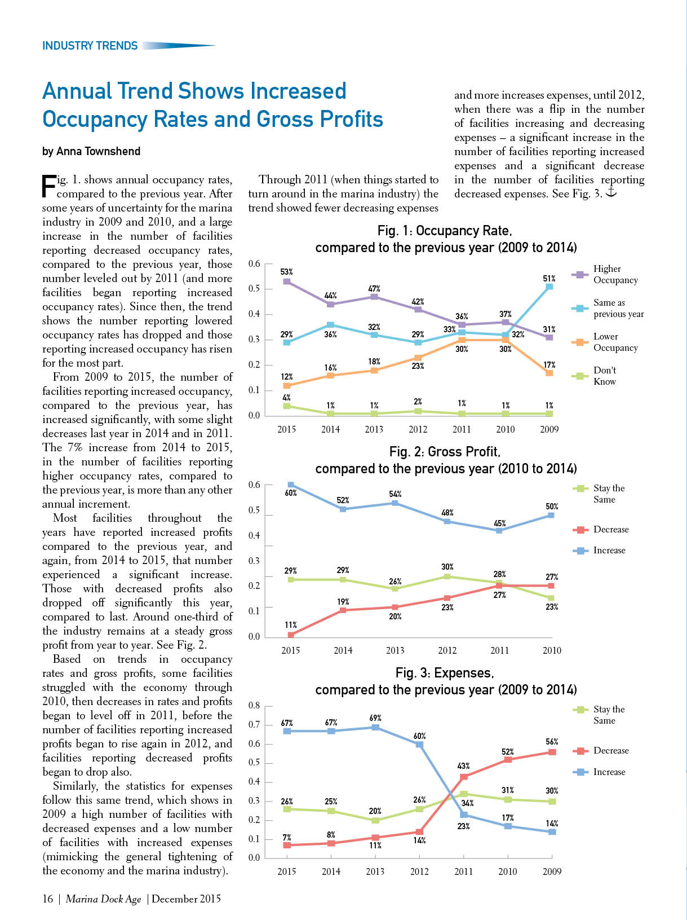
Annual Marina/Boatyard Industry Survey Trends
We’ve compiled data from 2009 to the present to show industry trends in occupancy rates, gross profits and expenses overtime.
Next report: December 2016 Trends issue
Link to current marina/boatyard industry survey:
www.marinadockage.com/survey

Slide 7
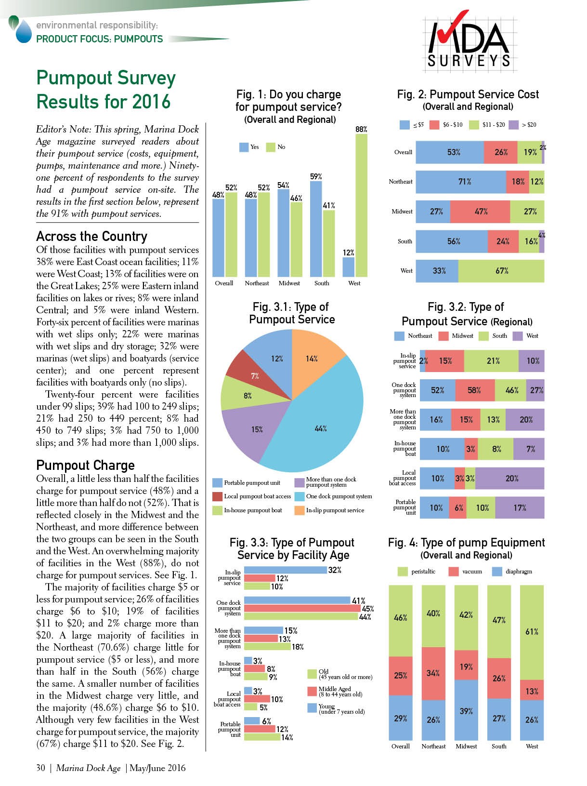
Other Surveys Topics:
Clean Marina
Wage Survey
Environmental Responsibility
Dry Storage
Safety/OSHA Compliance
Expanded topic/product coverage:
Other product surveys (pumpout, docks, software, fuel)
Part two industry survey (Business Operations)

Slide 8
2016 Pumpout Survey
Topics:
Do you charge for service?
Pumpout service cost
Type of pumpout service (in-slip pumpout; dock pumpout system; pumpout boat; portable pumpout)
Type of pump equipment (diaphragm; vacuum; peristaltic)
Pumpout equipment age
Pumpout maintenance schedule
The Breakdown (demographics):
By location
By type of waterbody
By type of facility
By type of ownership
By size (slips)
By facility age
By occupancy rate

Slide 9
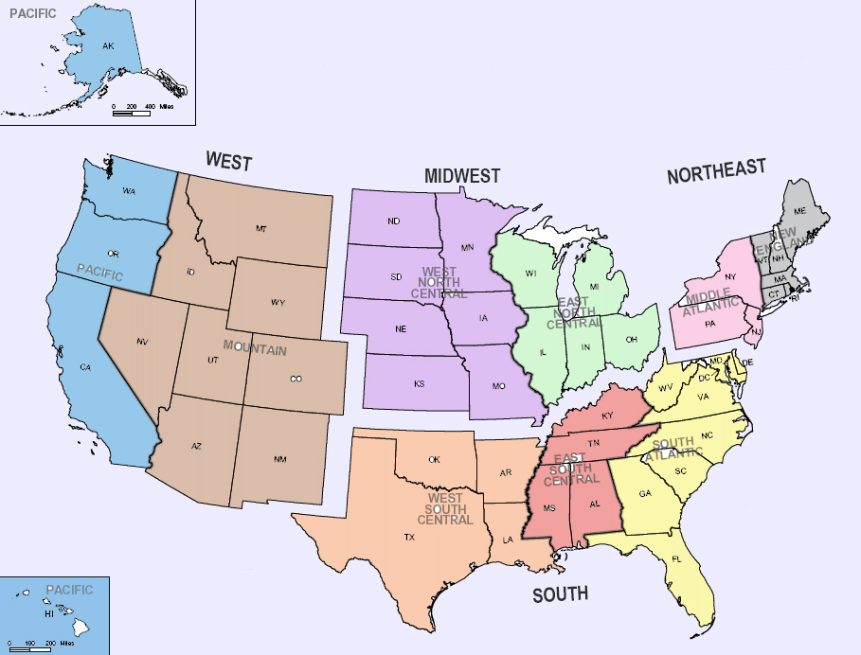
MIDWEST
15%
WEST
14.5%
NORTHEAST
25.5%
2.5%
12.5%
11%
14.5%
10%
37.5%
4.5%
4%
3.5%
SOUTH
45%
Respondent Profile

Slide 10
Respondent Profile facility size/# of slips
Large (more than 250 slips)-
33%
Small (less than 99 slips)-
24%
Medium (100 to 249 slips)
37%

Slide 11
Respondent Profile
Specific states
Type of waterbody
Type of facility
Ownership
Facility Age
Occupancy Rate
Do you offer pumpout service on-site?
91% -- YES
9% -- NO

Slide 12
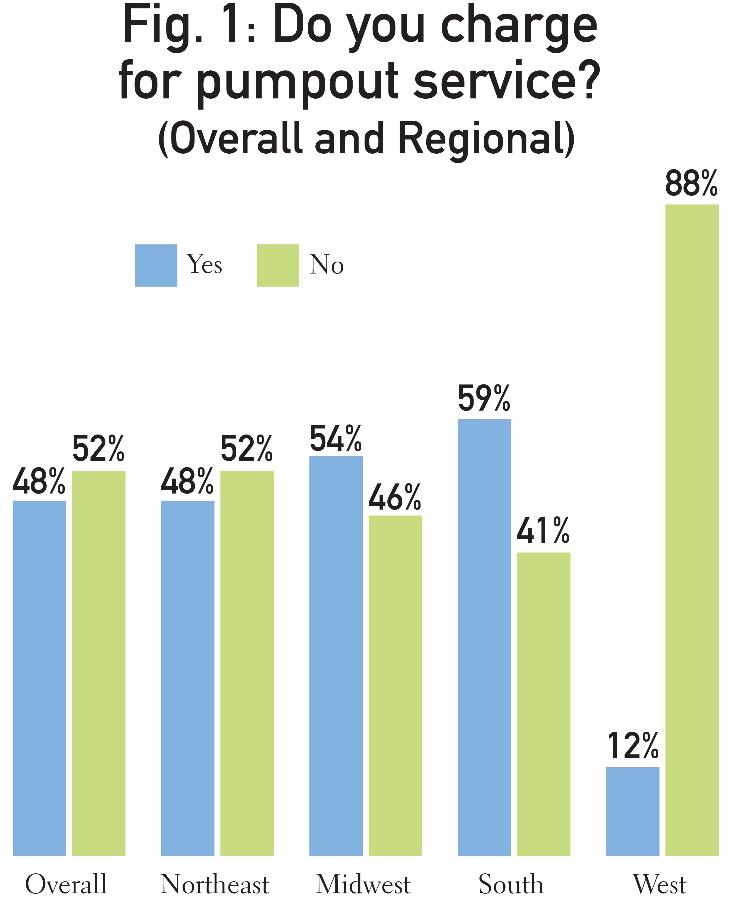
West has the largest difference in pumpout charge, with large majority not charging for service, compared to overall.
South has the largest number that charge for pumpout service.

Slide 13
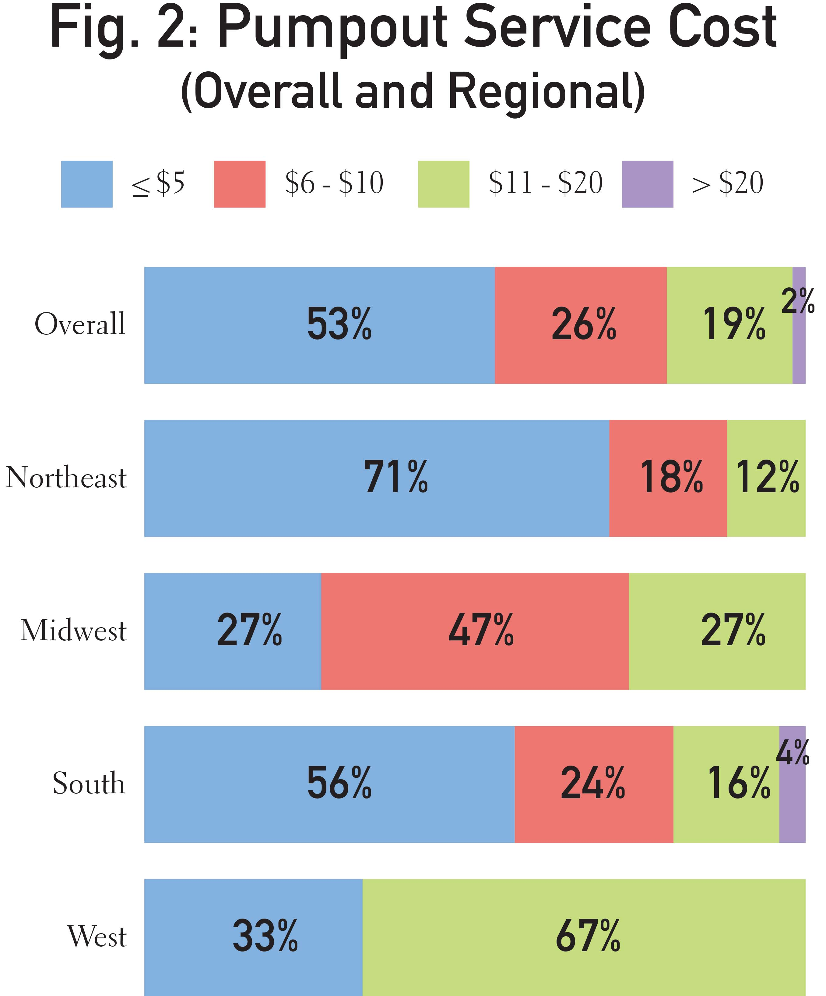
Overall, the majority of operators charge $5 or less per pumpout.
The regional stats are more varied.
A large majority of Northeast facilities charge $5 or less;
Fewer Midwest facilities charge $5 of less, compared to other regions and overall.
A large number of facilities in the West charge between $11 to $20.

Slide 14
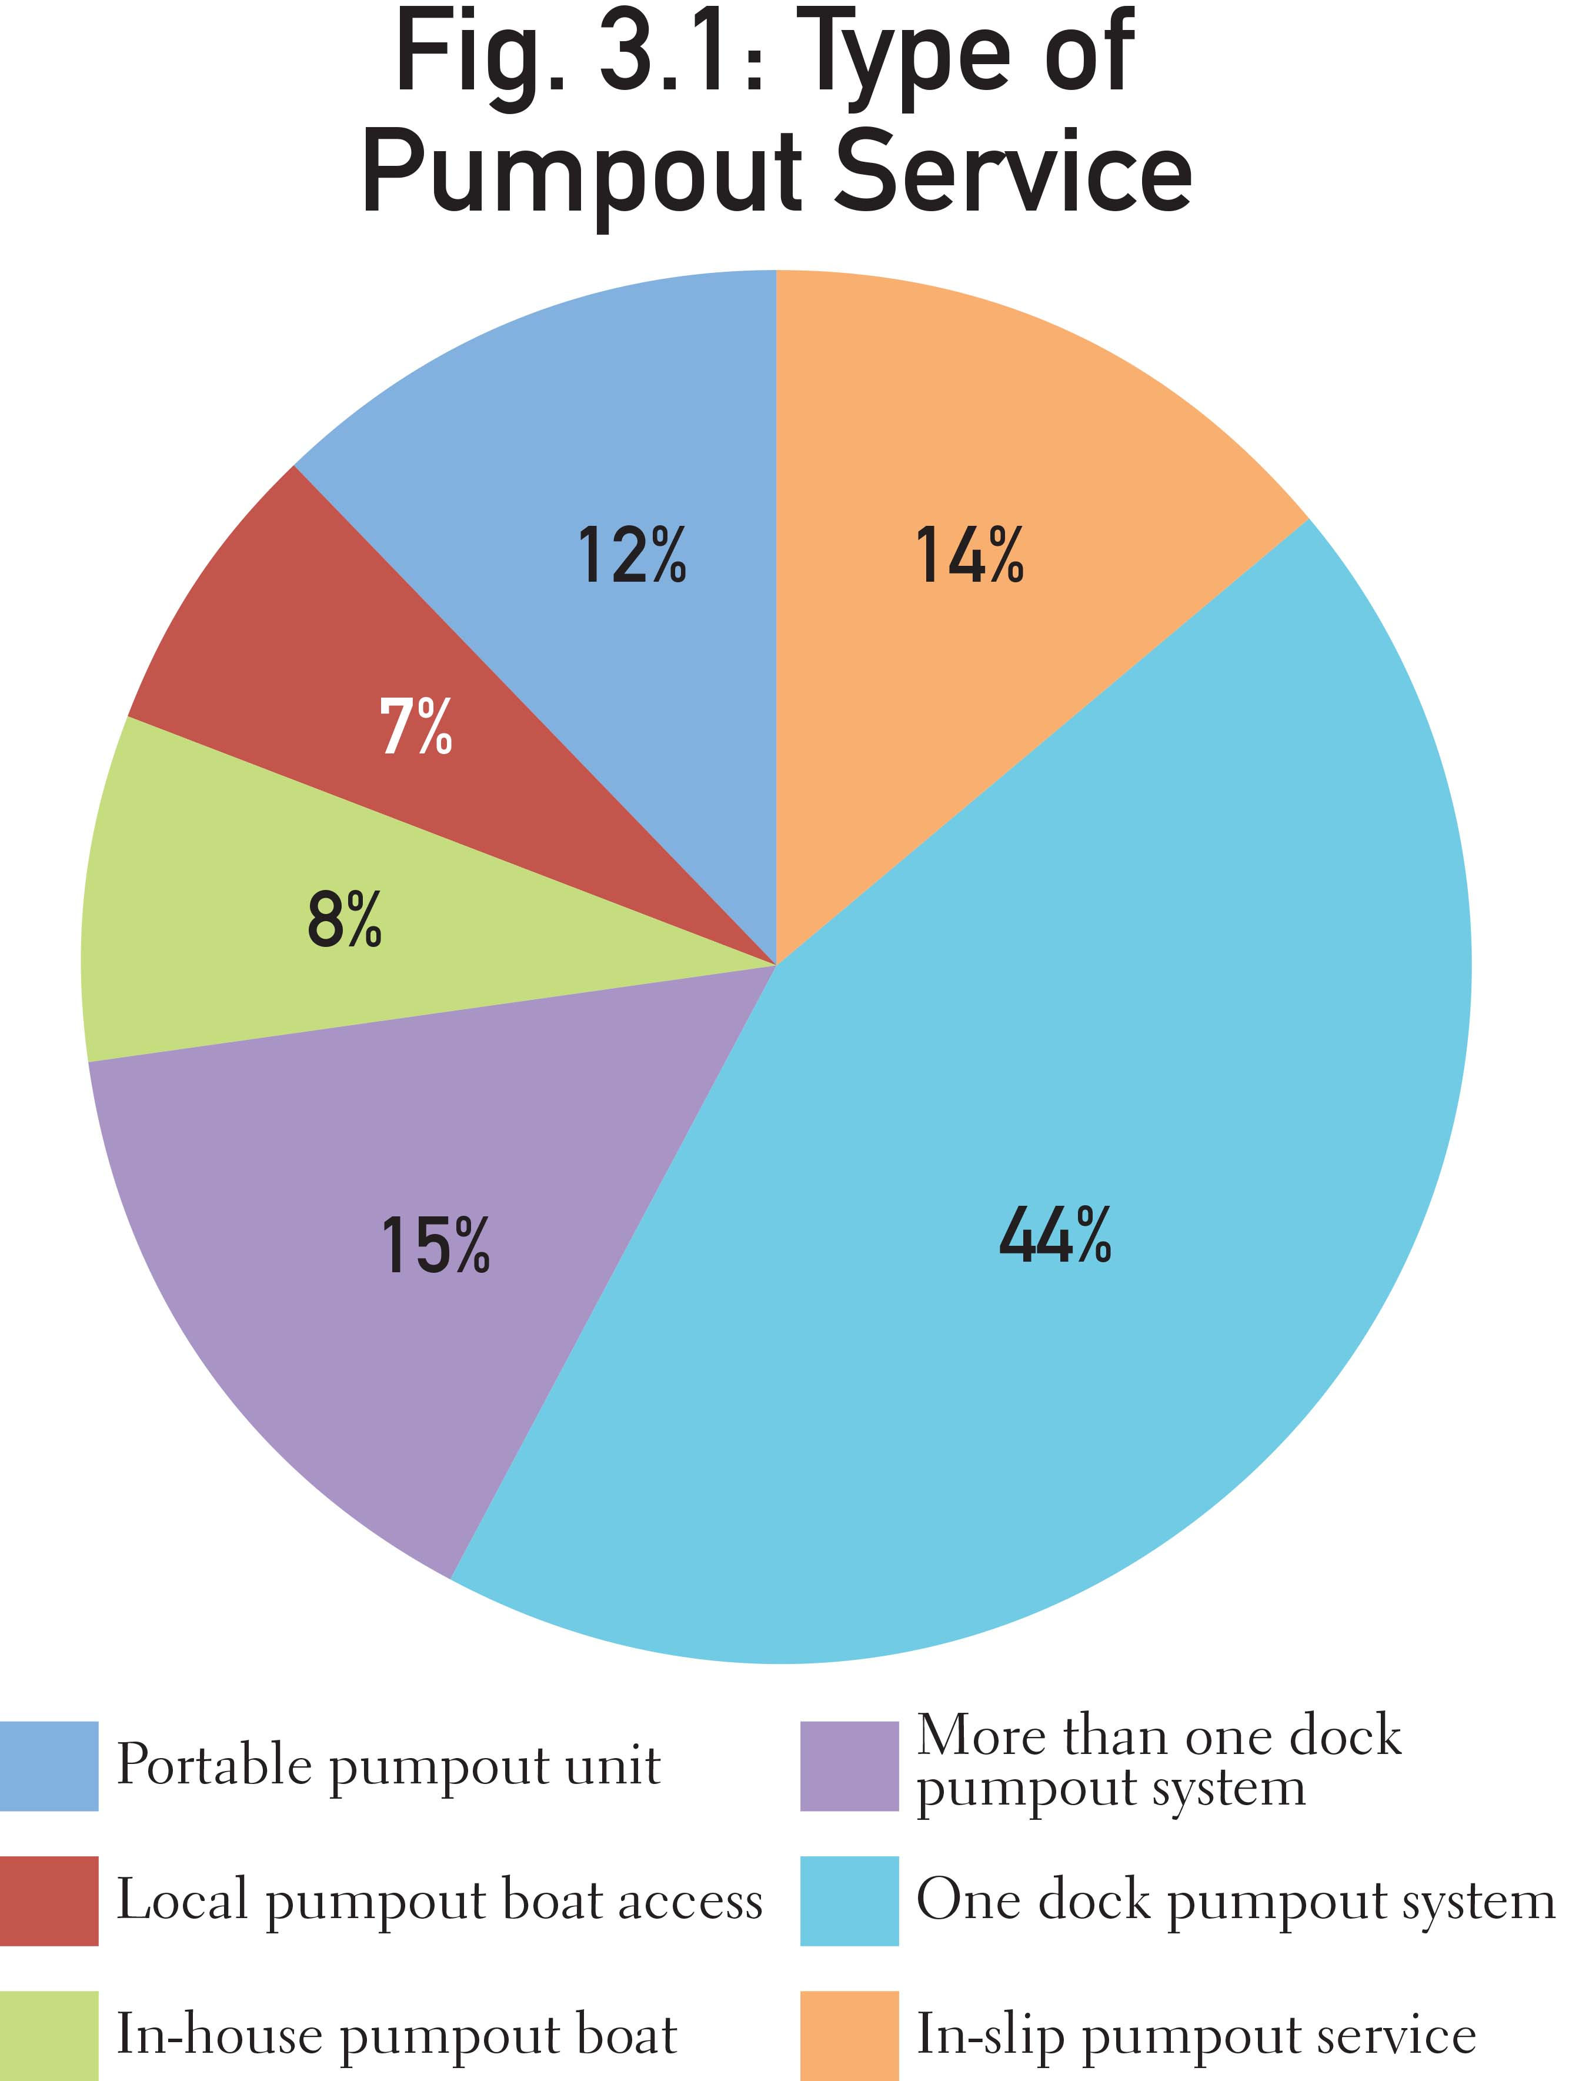
The majority of facilities have one or more dock pumpout system (59%);
More than one-quarter (25%) offer portable or in-slip units;
Fewer facilities offer their own pumpout boats or allow access for local boats.

Slide 15
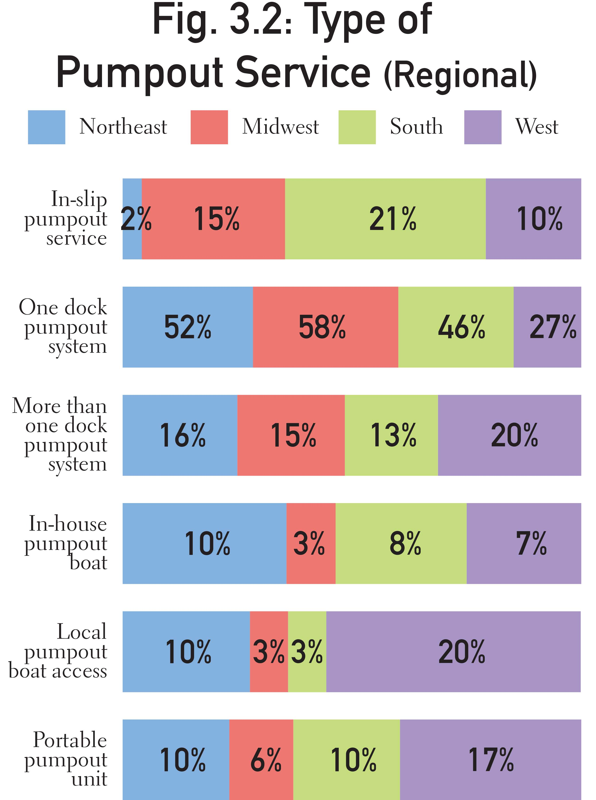
In-slip pumpouts are used by a larger number of facilities in the South.
Fewer facilities in the West offer one dock pumpout system, but a much larger number in the West offer more than one dock system, local pumpout boat access and portable pumpout units, compared to other regions.

Slide 16
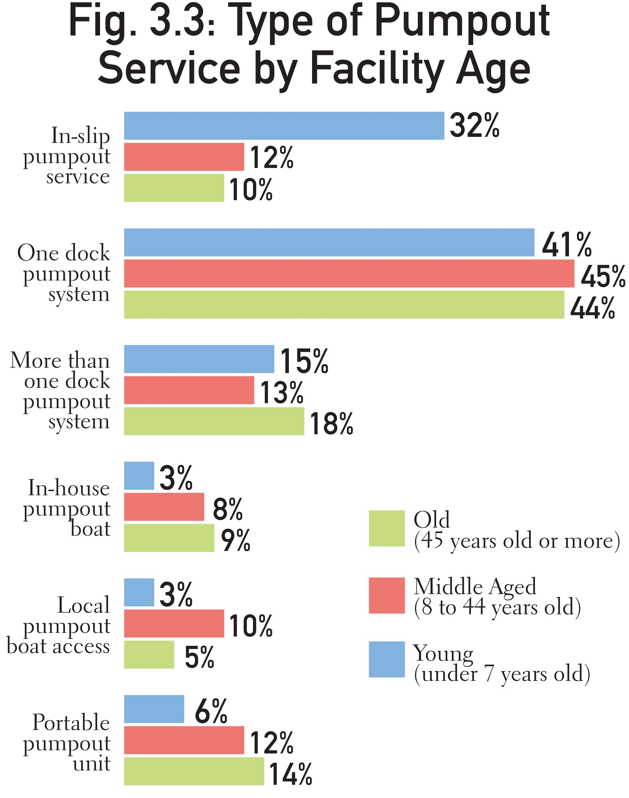
A large majority of young, newer facilities use in-slip pumpout service.
The majority, overall, regardless of age have one or more dock pumpout systems.
Fewer number of young, newer facilities are offering in-house pumpout boat service, compared to older facilities.

Slide 17
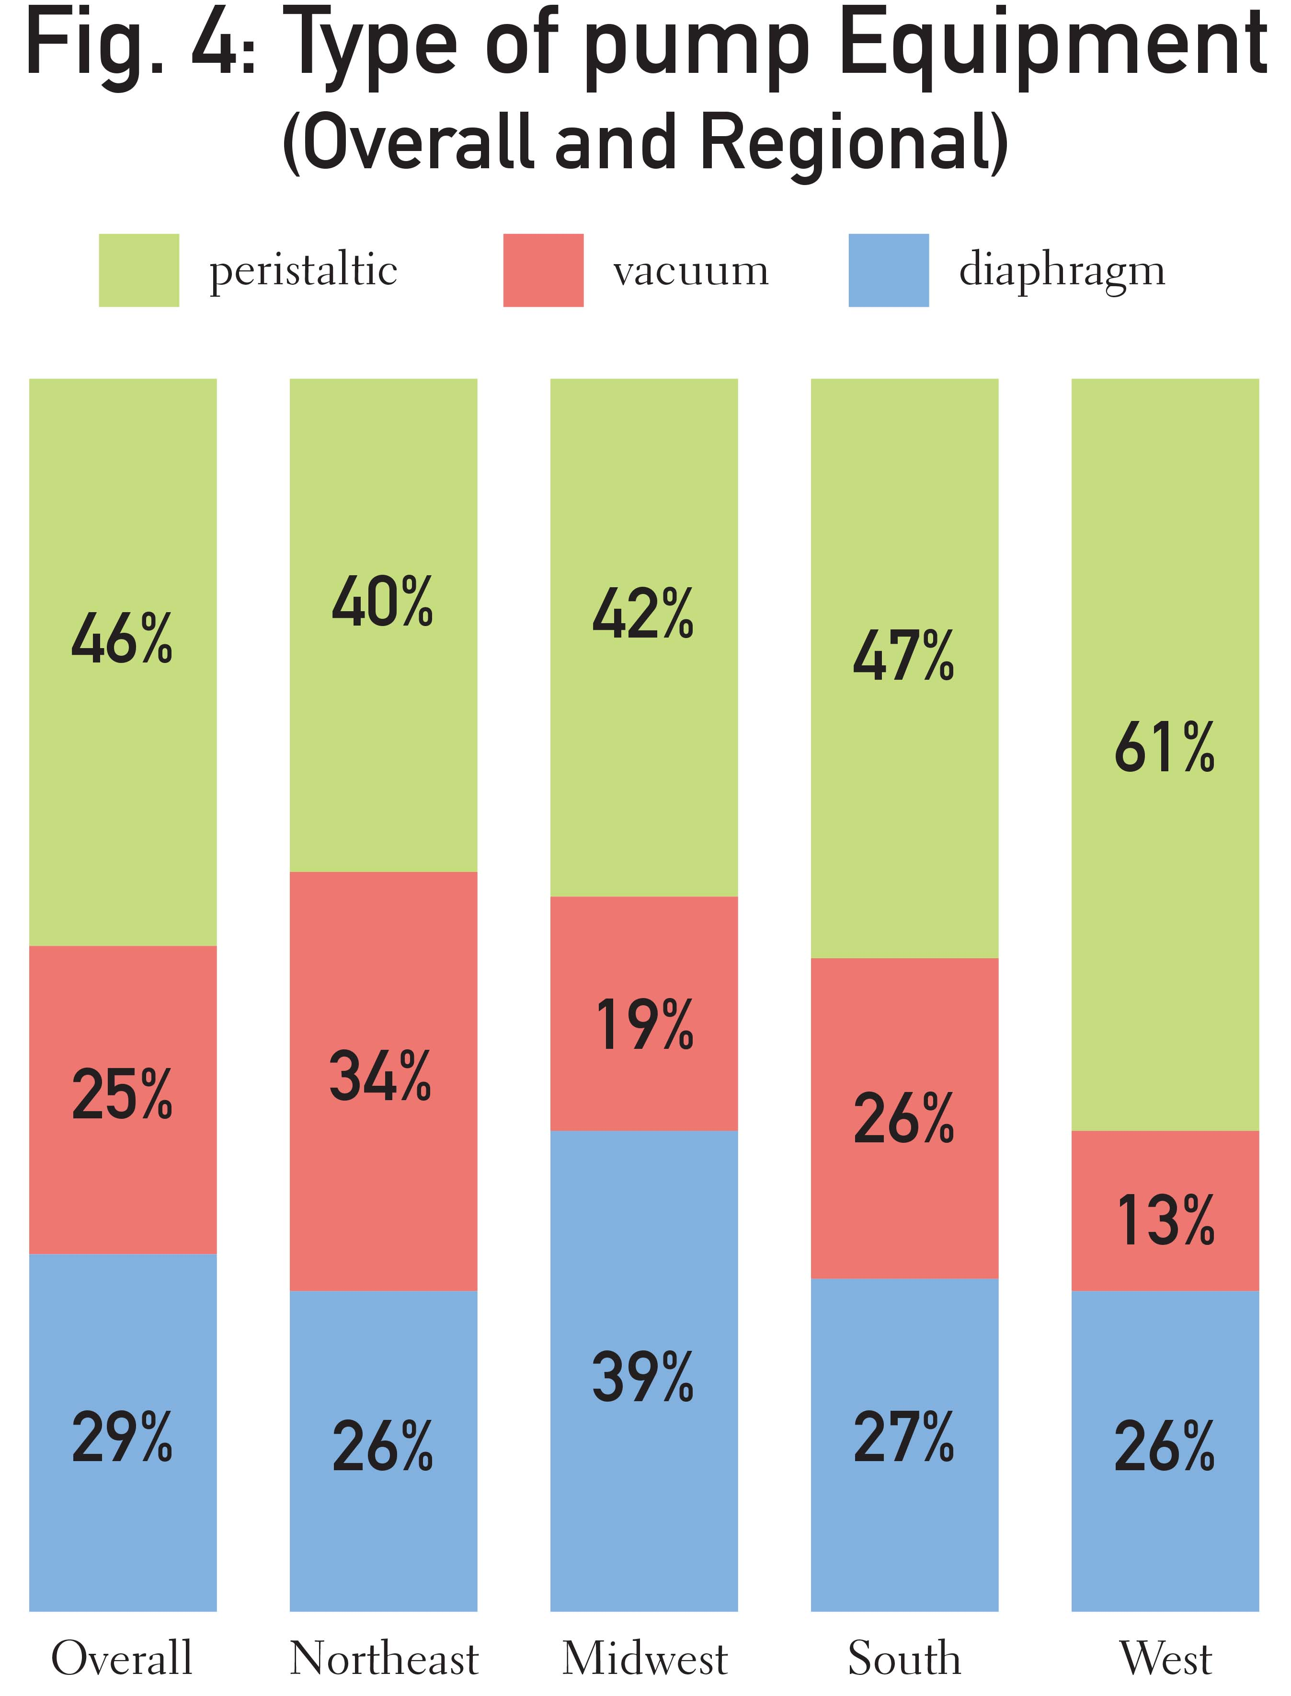
Diaphragm pump – works mechanically lifting a diaphragm up and down, working in conjunction with two valves;
Vacuum pump – draws air out of a tank, which creates the necessary low pressure to cause sewage to flow in;
Peristaltic pump – provides continuous suction by squeezing an internal flexible tube between rollers.

Slide 18
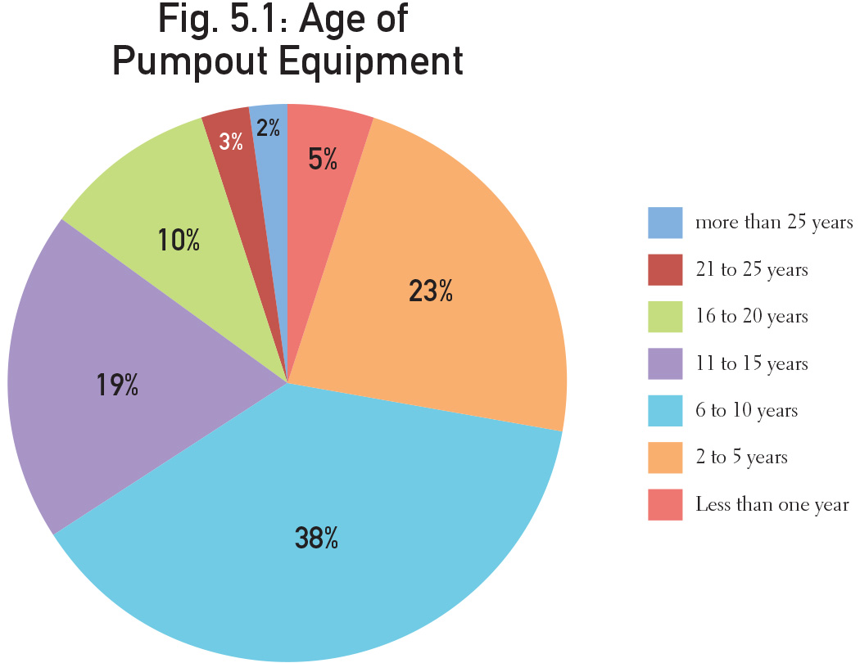
15% of equipment is more than 15 years old. Only 5% is more than 20 years old.
Majority (66%) –
less than 10 years old

Slide 19
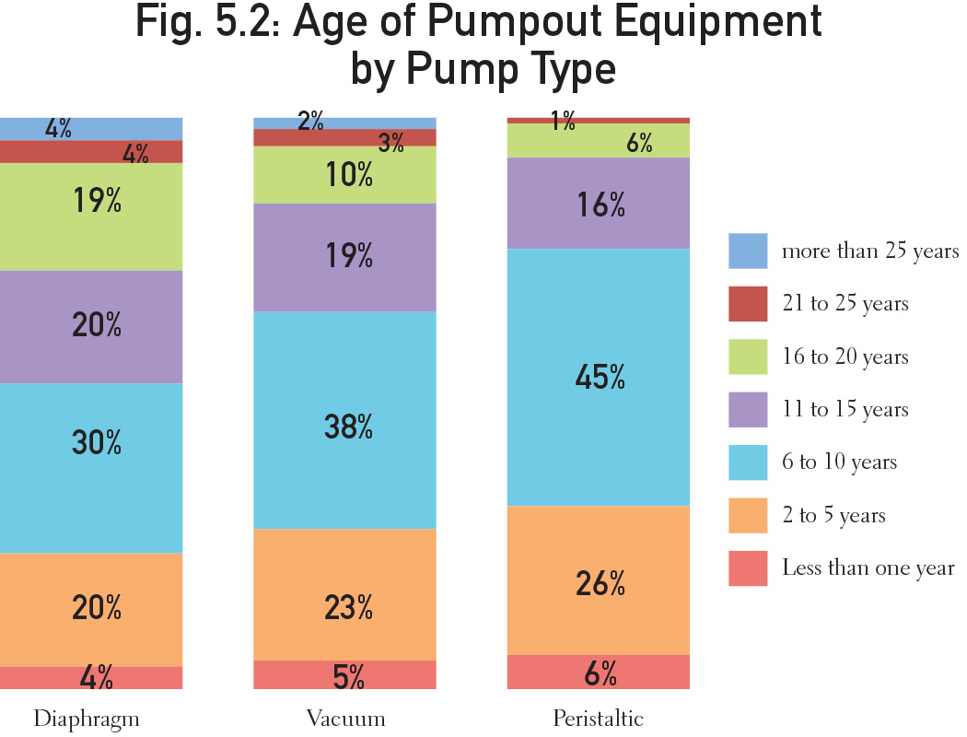

Slide 20
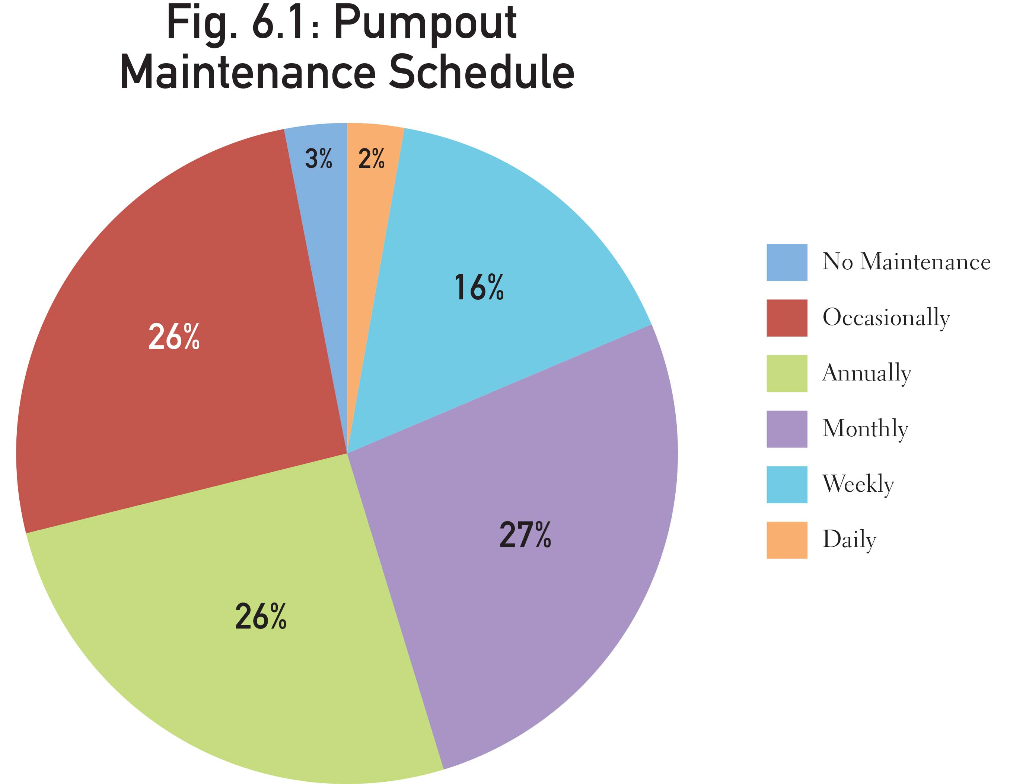

Slide 21
Pumpout Maintenance Schedule by Equipment Type

Slide 22
Questions?
Anna Townshend,
Marina Dock Age editor
atownshend@marinadockage.com
314-241-7355
Link to the current marina/boatyard industry survey:
www.marinadockage.com/survey
Survey open through October 21.

