Slide 1
Marina Industry Survey Why are survey statistics important?
Marina industry statistics are generally non-existent.
Vital for the growth of the industry (finding investors outside of firms that typically invest in marinas/waterfront development)
Vital to your own growth (gauging how your business performs against your peers)

Slide 2
Survey Topics
Respondent profile – does this reflect the general population?
Region
Waterbody
Size/#of Slips
Ownership
Type of facility
Age of the facility
Average boat size
Occupancy and Rates
Products/Services
Revenues and Expenses
Profit
National Perspective–gauge the overall health of the industry

Slide 3
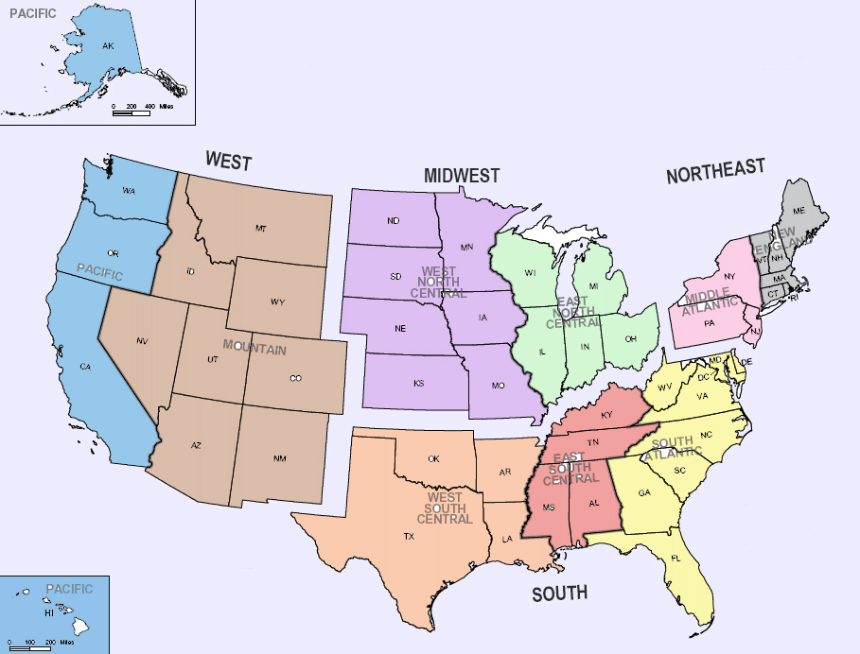
Respondent Profile
4%
12%
10%
11%
21%
18%
16%
16%
34%
46%
2%
4%
7%

Slide 4
Respondent Profile
waterbody
Great
Lakes
11%
Ocean-
West Coast
16%
Inland-
West
7%
Inland-
Central
12%
Ocean-
East Coast
32%
Inland-
East
23%

Slide 5
Respondent Profile (STATES)
States not represented:
Alaska
Arizona
D.C.
Iowa
Louisiana
Mississippi
Montana
Nebraska
Nevada
New Hampshire
North Dakota
Oregon
South Dakota
Utah
Vermont
West Virginia
Wyoming
Alabama – 1%
Arkansas – 0.4%
California – 13%
Colorado – 1%
Connecticut – 2%
Delaware – 0.4%
Florida – 15%
Georgia – 2%
Hawaii – 0.4%
Idaho – 0.4%
Illinois – 1%
Indiana – 0.4%
Kansas – 0.4%
Kentucky – 0.4%
Maine – 2%
Maryland – 4%
Massachusetts – 4%
Michigan – 4%
Minnesota – 1%
Missouri – 3%
New Jersey – 3%
New Mexico – 0.4%
New York – 7%
North Carolina – 5%
Ohio – 2%
Oklahoma – 1%
Pennsylvania – 2%
Rhode Island – 1%
South Carolina – 4%
Tennessee – 3%
Texas – 5%
Virginia – 5%
Washington – 3%
Wisconsin – 5%

Slide 6
Respondent Profile
facility type
48%
52%
Slips/Storage only
vs.
Service

Slide 7
Corporate
6%
Respondent Profile
ownership
Other 6%
Gov’t
15%
Private
73%

Slide 8
Respondent Profile size/# of slips
Large-
33%
Small-
30%
Medium-32%

Slide 9
Respondent Profile
facility age
New-3%
Mid-39%
Old-58%

Slide 10
Respondent Profile
average boat size
¼ mid-sized boats
Megayacht market small %
¾ majority

Slide 11
Respondent Profile
largest boat size

Slide 12
Questions?

Slide 13
Occupancy
Current overall rate %
GREAT!
39% at
mid-level occupancy
38% at good occupancy

Slide 14
Occupancy
Current rate %
(Regional)

Slide 15
Occupancy Rate % By waterbody

Slide 16
Occupancy RATE %
Facility size/# of slips

Slide 17
Occupancy % RaTE
Facility age
Large majority
1/3 new are struggling

Slide 18
Occupancy RATE %
Ownership

Slide 19
Occupancy RATE %
Facility type

Slide 20
Occupancy RATE %
Average boat size

Slide 21
2012 Occupancy
Compared to 2011
¼ lower
1/3 not growing
Majority higher

Slide 22
Occupancy
Overtime (2009-2012)

Slide 23
2012 Rates, compared to 2011
slips/storage/maintenance
Large majority unchanging
1/3 increased rates
Small %

Slide 24
Rates/regional

Slide 25
2012 Rates/by waterbody
No Decreases

Slide 26
2012 Rates/by facility size
Largest majority w/ increased rates

Slide 27
2012 Rates/by facility age

Slide 28
2012 Rates/by ownership

Slide 29
2012 Rates/by average boat size
Largest boats had largest decrease
0%

Slide 30
Products/Services What do you offer?

Slide 31
Products/Services
Overall revenues compared to 2011
In-water slips/services and storage
Largest increases
Service/Maintenance
Largest increases
Largest increases
Largest increases
Minority decreases

Slide 32
Products/Services
Overall revenues compared to 2011
Boat sales/rental
Extras
Largest increases
Largest increases

Slide 33
Products/Services Revenues BY REGION
West
Midwest
Northeast
South

Slide 34
Products/Services Revenues BY SIZE
SMALL-less than 100 slips
MEDIUM-100 to 250 slips
LARGE-more than 250 slips

Slide 35
Business Expenses What were they?

Slide 36
Overall Expenses compared to 2011
Large majority w/increases

Slide 37
Individual Expenses compared to 2011,
part one
Very small minority had decreases
Majority of expenses were same as 2011

Slide 38
Individual Expenses compared to 2011,
part two
Very small minority had decreases

Slide 39
Expenses highlights BY REGION
WEST
Midwest
NORTHEAST
SOUTH

Slide 40
Expenses highlights BY SIZE
SMALL-less than 100 slips
MEDIUM-100 to 250 slips
LARGE-10more than 250 slips

Slide 41
Expenses highlights BY AVERAGE BOAT SIZE
Increase
decrease
stay same
20 to 40 feet
41 to 60 feet
More than 81 ft
61 to 80 feet

Slide 42
Net Profit will you make one?
?
Large majority

Slide 43
Net Profit overtime

Slide 44
Net Profit by regions

Slide 45
Net Profit by waterbody

Slide 46
Net Profit by size

Slide 47
Net Profit by age

Slide 48
Net Profit facility type

Slide 49
Net Profit ownership

Slide 50
Net Profit average boat size
0% with no net profit

Slide 51
Discussion

