Slide 1
2014 Industry Survey

Slide 2
Marina Industry Survey Why are survey statistics important?
Industry performance statistics are underutilized by the marina industry.
Important for the growth of the industry (finding investors, especially firms new to marina/waterfront development)
Vital to your own growth and planning (gauging how your business performs against your peers)

Slide 3
Survey Topics
Respondent profile – does this reflect the general population?
Occupancy and Rates
Products/Services
Revenues and Expenses
Gross Profit
The Breakdown
Region
Size/#of Slips
Ownership
Type of facility
Age of the facility
National Perspective–gauge the overall health of the industry as a whole

Slide 4
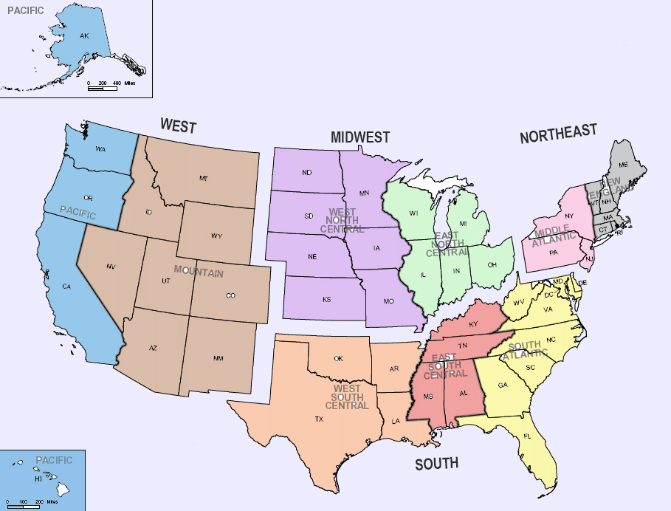
WEST
16%
MIDWEST
22%
NORTHEAST
22%
6%
16%
9%
13%
12%
31%
4%
4%
5%
SOUTH
40%
Respondent Profile

Slide 5
Respondent Profile
by waterbody
Great
Lakes
11%
Ocean-
West Coast
11%
Inland-
West
6%
Inland-
Central
14%
Ocean-
East Coast
35%
Inland-
East
21%

Slide 6
Respondent Profile (STATES)
Arizona –2%
California – 6.9%
Colorado – 1%
Connecticut – 3%
Delaware – 1%
Florida – 11.8%
Georgia – 2%
Illinois – 2%
Indiana – 1%
Iowa – 1%
Maine – 1%
Maryland – 3%
Massachusetts– 6.5%
Michigan– 4.5%
Minnesota – 3%
New Jersey – 3%
New York – 4.5%
North Carolina – 3%
Ohio – 4.5%
Pennsylvania – 2%
Rhode Island – 2%
South Carolina– 4.1%
Tennessee – 3%
Texas – 4.1%
Virginia – 6.9%
Washington– 4.1%
Wisconsin – 4.1%
States not represented:
Alabama
Alaska
Arkansas
D.C.
Hawaii
Idaho
Kansas
Kentucky
Louisiana
Mississippi
Missouri
Montana
Nebraska
Nevada
New Hampshire
New Mexico
North Dakota
Oklahoma
Oregon
South Dakota
Utah
Vermont
West Virginia
Wyoming

Slide 7
Respondent Profile
by facility type
52%
46%
Slips/Storage only vs.
Service

Slide 8
Respondent Profile
by ownership
Other 9%
Gov’t
18%
Corporate
12%
Private
61%

Slide 9
Respondent Profile facility size/# of slips
Very Large- 7%
Small-
20%
Large-
33%
Medium-36%

Slide 10
Respondent Profile
by facility age
New-8%
Middle Aged - 41%
Old-51%

Slide 11
Questions?

Slide 12
Occupancy
Current overall rate %

Slide 13
Occupancy Current rate %, by Regional

Slide 14
Occupancy Rate % By facility size

Slide 15
Occupancy RATE %
by ownership

Slide 16
Occupancy % RaTE
Facility age

Slide 17
Occupancy RATE %
Facility type

Slide 18
2014 Occupancy
Compared to 2013

Slide 19
Occupancy, compared to 2013, by regions

Slide 20
Occupancy, compared to 2013, by facility size

Slide 21
2014 Rates, compared to 2013
slips/storage

Slide 22
Rates, compared to 2013
by regions

Slide 23
2014 Rates/by facility size

Slide 24
2014 Rates/by facility age

Slide 25
2014 Rates/by ownership

Slide 26
Products/Services What do you offer?

Slide 27
Product/Service Revenues
compared to 2013 (part one)
In-water slips/services and storage
Service/Maintenance

Slide 29
Business Expenses What were they?

Slide 30
Overall Expenses compared to 2013

Slide 31
Individual Expenses compared to 2013

Slide 32
Gross Profit will you make one?

Slide 33
Gross Profit by regions

Slide 34
Gross Profit by size

Slide 35
Gross Profit, compared to 2013, by age

Slide 36
Gross Profit, compared to 2013,
by facility type

Slide 37
Gross Profit, compared to 2013
by ownership

Slide 38
Discussion

