Slide 1
THE CORONAVIRUS AND YOUR WORKPLACE
Presented by:
Travis Vance
Fisher & Phillips LLP
Robert Smith
Fisher Phillips Safety Solutions March 23, 2020

Slide 2
BACKGROUND
Good news- a majority of individuals recover.
Coronaviruses are a family of virus that can cause fever, respiratory problems, and sometimes gastrointestinal issues.
The latest novel coronavirus is being labeled COVID-19.
The outbreak was first detected in December in Wuhan, the capital of China’s Hubei province.
Spreads through coughs and sneezes like a common cold. You can also likely acquire the virus after touching a surface containing the virus and touching your mouth. 1 person on average spreads it to 2-3 others.
Individuals in more than 100 countries have been infected.
Declared a pandemic on 3/11 and national emergency on 3/13.

Slide 3
BACKGROUND
Over 35,000 confirmed cases in the United States; Over 200 deaths*.
First possible community transmission case in U.S. confirmed on 2/27.
CDC believes the you may be may be able to be spread COVID-19, like the Zika virus, prior to showing symptoms. Officials are not sure if the virus can be spread by handling or touching objects where the virus may have been present.
House Bill passed on Saturday, 3/14 addressing sick pay and emergency FMLA; signed into law on 3/18.
*As of 4pm update on March 20.

Slide 4
Where We Are Now
Accept that every day brings new facts and guidance. We must try to plan, but next week will be VERY different.
Fed and State Actions, and School and Business Closures.
Bad News – cases will rapidly increase in all areas and disruptions in travel, gatherings, business, and education will occur.
What news greeted you today? The exponential increase will be revealed this week.
Consider that an Italy-like response may be a wise move to limit spread.
See today’s news and more coming.
We have to balance messages – not too dark versus being too optimistic.
Many people are still not taking this seriously. Others are nervous but hoping for few changes.
It’s time for the CEO’s role – making the tough risk weighing decisions based on sound advice of HR, Legal, Operations, and Safety.
Next step will be to set the tone for pulling together and protecting the business. Need Authentic Leadership.

Slide 5
Considerations for employers
Educate all employees about how the coronavirus can be contracted.
Establish a point of contact in human resources or elsewhere in your company for employees that have concerns.
Remind employees about policies concerning absences and working from home, including vacation, sick pay, FMLA, unemployment, and short term disability.
Train supervisors on overreaction impacts and importance of adhering to antidiscrimination policies.
Keep track of updates from CDC and WHO.
Employee personal travel:
Employers cannot prohibit otherwise legal activity, such as personal travel abroad by an employee. This includes pregnant employees or those with a medical condition.
Employers should advise employees traveling to areas where Coronavirus is an issue to take proper precautions.

Slide 6
US Department of State Travel Warnings
March 19, 2020- US Dept. of State issued Global Level 4 Health Advisory.
Advised all US citizens to avoid travel abroad.
US citizens currently abroad should return immediately or prepare to remain abroad for indefinite period of time.
May impact transient boaters who have taken their vessels out of US Territory.

Slide 7
Continue Preparing and Adapting
This week is crucial – time is running out for certain actions.
Is your Remote/VPN ready?
Ensure Business Continuity – and shift to preparing for shutdowns and limited operation for uncertain periods.
Daily monitor developments and quickly weigh risks and make decisions.
Accept the lack of legal precedent and the need to weigh risk and make your best possible decision – process-driven and not prescriptive decision making.
Consider rapidly developing legislative developments.
Be aware of family issues and stress – anxiety – elder care concerns – school kids home – financial future.

Slide 13
Considerations for employers
Educate your supply chain.
Can you ask employees to stay at home if they exhibit symptoms of coronavirus or the flu? Yes. Ask them to seek medical attention and get tested for COVID-19. Can you ask an employee why he or she missed work? Yes. Can you ask them to leave work? Yes, under most circumstances.
Many clients are requesting medical notes from employees prior to returning to work, especially that was a prior practice. However, EEOC and OSHA has cautioned employers that employees may not be able to reach physicians.

Slide 14
New CDC Guidance on Returning to Work
1) Time-since-illness-onset and time-since-recovery strategy (non-test-based strategy)*
Persons with COVID-19 who have symptoms and were directed to care for themselves at home may discontinue home isolation under the following conditions:
At least 3 days (72 hours) have passed since recovery defined as resolution of fever without the use of fever-reducing medications and improvement in respiratory symptoms (e.g., cough, shortness of breath); and,
At least 7 days have passed since symptoms first appeared.
2) Test-based strategy (simplified from initial protocol) Previous recommendations for a test-based strategy remain applicable; however, a test-based strategy is contingent on the availability of ample testing supplies and laboratory capacity as well as convenient access to testing. For jurisdictions that choose to use a test-based strategy, the recommended protocol has been simplified so that only one swab is needed at every sampling.
Persons who have COVID-19 who have symptoms and were directed to care for themselves at home may discontinue home isolation under the following conditions:
Resolution of fever without the use of fever-reducing medications and
Improvement in respiratory symptoms (e.g., cough, shortness of breath) and
Negative results of an FDA Emergency Use Authorized molecular assay for COVID-19 from at least two consecutive nasopharyngeal swab specimens collected ≥24 hours apart** (total of two negative specimens). See Interim Guidelines for Collecting, Handling, and Testing Clinical Specimens from Persons Under Investigation (PUIs) for 2019 Novel Coronavirus (2019-nCoV)for specimen collection guidance.
3) Individuals with laboratory-confirmed COVID-19 who have not had any symptoms may discontinue home isolation when at least 7 days have passed since the date of their first positive COVID-19 diagnostic test and have had no subsequent illness.

Slide 15
List Your Issues
Getting employees to come to work.
Protecting Employees and limiting opportunities for spread.
Office setting? Retail or Hospitality? Healthcare? Employees going to commercial or home sites? Travel?
Excluding people who may have been exposed.
How to keep sick employees from coming to work?
PTO/Sick Pay?
How funded?
What happens when PTO is exhausted?
Attendance rules.
Wage Hour compliance.
Avoiding setting precedents.

Slide 16
Masking the problem?
Under OSHA’s respiratory protection standard, a respirator must be provided to employees only “when such equipment is necessary to protect the health of such employees.”
OSHA rules provide guidance on when a respirator is not required: “an employer may provide respirators at the request of employees or permit employees to use their own respirators, if the employer determines that such respirator use will not in itself create a hazard” (29 C.F.R. 1910.134(c)(2)).

Slide 17
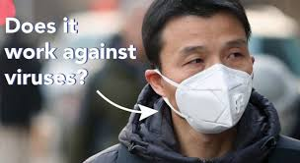
Masking the problem?
The World Health Organization (WHO) has stated that people only need to wear face masks if they are treating someone who is infected with the coronavirus.
Doctors agree that the best defense is simply washing your hands.
There are more appropriate measures of defense than wearing a surgical mask or respirator.

Slide 18
Can an employee simply refuse to work?
An employee’s right to refuse to do a task is protected if all of the following conditions are met:
Where possible, you have asked the employer to eliminate the danger, and the employer failed to do so; and
You refused to work in “good faith.” This means that you must genuinely believe that an imminent danger exists; and
A reasonable person would agree that there is a real danger of death or serious injury; and
There isn’t enough time, due to the urgency of the hazard, to get it corrected through regular enforcement channels, such as requesting an OSHA inspection.
It likely would violate OSHA’s general duty clause if you fail to notify employees of a confirmed case working in close proximity.

Slide 19
HAZARD COMMUNICATION REQUIREMENTS
OSHA’s Hazard Communication standard addresses the issue of communicating information concerning hazards of chemicals and appropriate protective measures to employees.
1910.1200(h)(1): “Employers shall provide employees with effective information and training on hazardous chemicals in their work area at the time of their initial assignment, and whenever a new chemical hazard the employees have not previously been trained about is introduced into their work area.”
A comprehensive hazard communication program should include container labeling and other forms of warning, safety data sheets and employee training.
Ensure that employees that are conducting non-typical tasks (e.g., cleaning issues) are properly trained on that task.

Slide 20
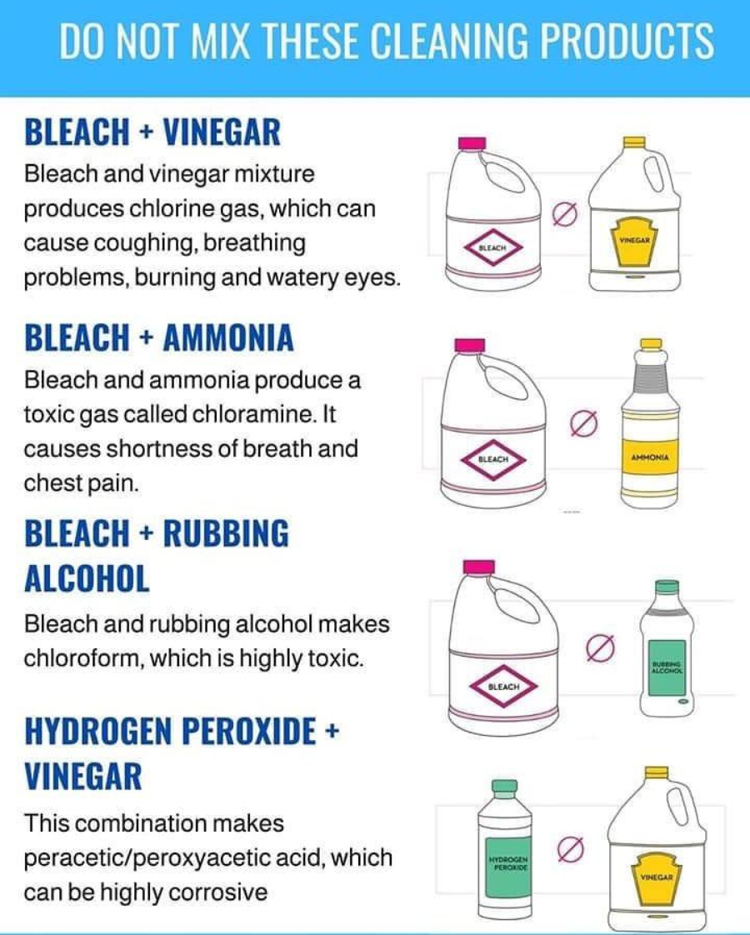

Slide 21
BLOOD BORNE PATHOGENS
If employees in your workplace are required to clean up or be exposed to blood or other bodily fluids as part of their regular job, employers must:
Develop a written exposure control plan.
Provide Employee training on Blood Borne Pathogens.
Make Hepatitis B Vaccine available to employee with exposure.
Provide Personal Protective Equipment (e.g. gloves/goggles).

Slide 22
Practical takeaways
Encourage employees to wash their hands. Ensure that proper hand washing tools/soap is available.
Educate your workforce about issues such as social distancing and how to identify symptoms.
Allow employees to work from home if possible.
Encourage employees to not return to work until their temperature drops below 100.4 Fahrenheit for at least 24 hours.
Encourage employees to not touch their faces, eyes, and mouth.
Increase custodial/sanitizing schedules to the extent possible.
Encourage employees to contact a doctor if they develop symptoms of the coronavirus and be tested.

Slide 23
Practical Steps to Protect Employees and Limit Spread
Increase Availability of Hand Cleaner, screen and keyboard wipes, and Kleenex.
Evaluate jobs for improving social separation.
Evaluate remote work opportunities.
Encourage seasonal flu shots.
Emphasize Wellness Program efforts to maintain general health.
Eldercare assistance.
Provide PPE as appropriate and document training.

Slide 24
FAMILIES FIRST CORONAVIRUS RESPONSE ACT OVERVIEW
Passed House on 3/14/2020; House changes made late 3/16/2020 for “technical corrections”
Passed by Senate on 3/18/2020.
Paid and Unpaid Leave for Coronavirus-Related Reasons
Emergency Paid Sick Leave
Emergency Family and Medical Leave Act (Expands FMLA)
Emergency Unemployment Insurance Stabilization And Access Act of 2020
Unemployment Insurance Funding
Reimbursement to Employers as Tax Credits

Slide 25
EMERGENCY PAID SICK LEAVE

Slide 26
EMERGENCY PAID SICK LEAVE
Employers with 1-499 employees
Employees are counted if in the United States, the District of Columbia, or any territory or possession of the United States.
Any employee who works for employer is eligible
No minimum days/hours of employment
If the EMPLOYEE is sick, employee is entitled to:
Full-time Employees – 80 hours of paid sick leave
Part-time Employees – Paid based on the average number of hours the employee worked for the six months prior to taking this paid sick leave.
Or, if employed for less than 6 months, the average number of hours per week the employee would normally be scheduled

Slide 27
EMERGENCY PAID SICK LEAVE Qualifying Reasons
Must provide paid sick time “to the extent the employee is unable to work (or telework) due to a need for leave because:
The employee is subject to a federal, state or local quarantine or isolation order related to COVID-19.
The employee has been advised by a health care provider to self-quarantine due to concerns related to COVID-19.
The employee is experiencing symptoms of COVID-19 and seeking a medical diagnosis.
The employee is caring for an individual who is subject to an order or self-quarantine as described above.
The employee is caring for a son or daughter if school or child care is closed/unavailable.
The employee is experiencing “any other substantially similar condition” specified by HHS (catch all).

Slide 28
EMERGENCY PAID SICK LEAVE
At employee’s regular rate for qualifying reasons (1), (2) or (3)
Compensated at HIGHER of their regular rate, federal minimum wage or local minimum wage
At 2/3 the employee’s regular rate for qualifying reasons (4), (5) or (6)
Capped at the following levels:
$511 per day and $5,110 in the aggregate per person for qualifying reasons (1), (2) and (3).
$200 per day and $2,000 in the aggregate per person for qualifying reasons (4), (5) and (6).

Slide 29
EMERGENCY PAID SICK LEAVE
At employee’s regular rate for qualifying reasons (1), (2) or (3)
Compensated at HIGHER of their regular rate, federal minimum wage or local minimum wage
At 2/3 the employee’s regular rate for qualifying reasons (4), (5) or (6)
Capped at the following levels:
$511 per day and $5,110 in the aggregate per person for qualifying reasons (1), (2) and (3).
$200 per day and $2,000 in the aggregate per person for qualifying reasons (4), (5) and (6).

Slide 30
EMERGENCY FAMILY AND MEDICAL LEAVE

Slide 31
EMERGENCY FAMILY AND MEDICAL LEAVE ACT
Employers with 1-499 employees
Employees are counted if in the United States, the District of Columbia, or any territory or possession of the United States.
A corporation is a single employer, rather than its separate establishments or divisions
Separate entities will be one employer if they meet either the joint employer or integrated employers tests (as set forth in FMLA regulations)
Significantly expands FMLA on a temporary basis
Any employee who worked for employer for 30 days prior to leave and has a qualifying reason is eligible (no requirement of 12 months/1250 hours)
Provides up to 12 weeks of job-protected leave (paid after the first 10 days)

Slide 32
EMERGENCY FAMILY AND MEDICAL LEAVE ACT Qualifying Reasons
12 weeks of job protected leave when:
“The employee is unable to work (or telework) due to the need for leave to care for the son or daughter under 18 years of age of such employee if the school or place of care has been closed, or the child care provider of such son or daughter is unavailable, due to a public health emergency.”
Likely FMLA definition of “son or daughter” will apply.
“Public Health Emergency”
An emergency with respect to COVID-19 declared by a Federal, State or local authority

Slide 33
EMERGENCY FAMILY AND MEDICAL LEAVE ACT How Does it Work
First 10 days of EFMLA may be unpaid
An employee may elect to substitute accrued PTO, vacation, or sick leave to cover any portion of first 10 days
Employer cannot require an employee to substitute such leave
After the first 10 days:
Compensated at 2/3 of the regular rate
Part-time employees/irregular schedule entitled to be paid based on average number of hours employee worked in prior 6 months, or if employed less than 6 months, average number of hours employee would normally be scheduled to work
Pay capped at $200 per day and $10,000 in aggregate per employee
Bargaining unit employees – apply EFMLA consistent with the CBA

Slide 34
A FEW THINGS TO KEEP IN MIND
State and Local Laws
Many states and local jurisdictions have their own paid sick days and family and medical leave laws, which may be in addition to these new federal requirements.
Many states and locals are working quickly to amend their laws and/or add new requirements as well.

Slide 35
Questions?

Slide 36
Thank You
Travis Vance Phone: (704) 778-4164 Email: tvance@fisherphillips.com
Robert Smith
Phone: (404) 240-4147
Email: rsmith@fpsafetysolutions.com

